Slide 1


Introduction to BCIS Project
Part 1- COMP702/COMP708
Olivia Tang, Prof. Catherine Shi & Dr Ramesh Lal

Slide 2
Workshop Agenda
Provide Information on various key aspects of the R & D paper
Project allocation
BCIS project teaching team
Workshop & off-site schedules, assessments, worklog book, portfolio, teamwork
Project proposal- the first assessment
Things to do for the week

Slide 3
Project Allocations S2 2025
Team allocation will be done tomorrow; by the end of Monday, notifications will be emailed to you.
EOI for projects closed Wednesday (11.59 pm). If you did not submit one, we will assign you to a project based on your major.
We have 45 Part 2 teams (251 students). The estimated number of Part 1 Teams for this semester is 35 and 37 teams (around 160 Students).
Team capacity (size) for R&D projects; 5-6 students per team.
We look at your majors, GPA, and preferences, if we have received your
EOI on time. Late submission before Friday morning is ok.
Some projects have more EOIs. GPA is a major factor for team allocation
Most people should get the project they listed in their EOI. Some will not get any of the projects they had chosen
We do our best to ensure the projects provided are doable, but projects have many uncertainties. Part of your project journey involves understanding and scoping the project – this means that what you initially start may change as you work with your client.

Slide 4
But I want to change my project...
As a general rule, we do not allow project changes – it takes a significant amount of work to place you in a team and project.
When is a change request considered?
A personal conflict of interest and evidence must be supplied
e.g. one of your parents is the client
A workplace conflict of interest and evidence can be supplied
e.g. I work for a company in the same industry, and my contract does
not allow me to work with a competitor
When is a change request not considered? Common examples of requests we refuse include:
You don’t like the project
You want to work with people you have worked with before
You don’t want to work with one or all of the team members

Slide 5
BCIS Project Teaching Team 2025 (Stakeholders)
Paper leaders & TA:
Dr Ramesh Lal, ramesh.lal@aut.ac.nz (WZ1114, 6323)
Prof Catherine Shi, catherine.shi@aut.ac.nz (WZ1118)
Olivia Tang (TA), olivia.tang@aut.ac.nz (WZ Level 11) (Master in Project & over 15 years of industry experience, including being an agile coach in a distributed (global) large-scale software development environment. She will pursue a PhD in agile metrics this semester.
Responsible for delivery of the BCIS R&D project course (COMP702/COMP703- 30 points) including the conjoint course (COMP708/COMP709-60 points).
Contact us for aspects related to workshops, assessments, projects, clients, supervisors, resources, or team issues.
Email one and CC the other two
Workshops:
COMP702 (Part 1 Sem 1) - Ramesh
COMP703 (Part 2 Sem 2) – Catherine
COMP708 & COMP709- Ramesh & Catherine, we both will be jointly delivering these two conjoint courses
Industry advisor: Leanne Bint WZ12, leanne.bint@aut.ac.nz
She works with the industry to source R&D projects. Leanne will help us with any issues related to project clients.
She wants us to have a solid working relationship with the clients and deliver what we agree to deliver.
Project administrator (CMS admin):
Chris Nguyen <chris.nguyen@aut.ac.nz>. Chris handles enrolments, withdrawals & attendance records, etc. Her contact email-
cmsundergrad@aut.ac.nz or chris.nguyen@aut.ac.nz
Team supervisor and moderator: for marking all the assessments
Each team will have the same supervisor and moderator for both semesters. Your team is expected to work closely with the supervisor. Must aim for a weekly team meeting with the supervisor
A supervisor’s role is to understand how the team is functioning and work achievement to date for assessment marking purposes.
He or she may support the team by giving feedback or may even provide some ideas or suggestions, but will not do any work for the team or even micro-manage the team.
Moderator helps with marking the assessments

Slide 6
BCIS Project Teaching Team 2025 (Stakeholders)
Marking panel for the team’s poster
Team marking for the poster assessments consists of 3 academics (can include the team moderator) and may also include an industry person. Mentors will not be part of the panel which will mark your team’s poster
Project client- project sponsor
We expect your team will work closely (regular meetings) with the client. He/she or someone from the organization must validate your project deliverables throughout the project timeline.

Slide 7
R & D paper (project)- why it is a critical paper?
A core paper- a requirement for the BCIS qualification.
This paper is about applying knowledge and skills to solve a client’s problem to their satisfaction.
Provides industry experience and understanding for undertaking IT projects
Ability for continuous learning- self-learning and learning on the fly
New learnings and skills-
technical skills, frameworks, tools and technology, WBS, processes, practices, project management, teamwork (task sharing), communication and interaction, negotiation skills, etc.
Develop emotional maturity and feel confident to apply for IT jobs
use the R & D experience (specific examples from above) to answer interview questions (have reality or facts)
Note:
Requires behavioural change
Requires 100% effort on your part for two semesters
Requires consistent effort, on average 12/15 hours per week
Not pushing the work to the last minute

Slide 8
Your project deliverable- a functional prototype
Not delivering for production environment- it is just a prove of concept that would be delivered to the client.
An initial release of artefacts or a product (a functional prototype) that can be learned
from for a full implementation later
Your team is not producing a working software or a product that could be deployed in the production environment
The prototype will enable the client to test the artifacts, identify design improvements, and identify issues to be fixed, before it is fully implemented for the production environment. Hence, client will do a full implementation for their production environment.
Expected approach to deliver the functional prototype
Use short cycle approach but not a big bang approach
Active involvement of the client for real-time information and feedback
It can be both, low-fidelity (paper design/screen shots) or high-fidelity (working
software) prototype
Note: it is the team’s responsibility to create this awareness with the client

Slide 9
Canvas: Course materials and announcements
Both are offered through a single instance on Canvas:
Part 1 & Part 2
COMP703 2025_02 R & D Project-
BCIS R&D Project – COMP702 and COMP703;
Conjoint Research Project- COMP708 and COMP709
•
•
You should have access to Canvas. If not, please email cmsundergrad@aut.ac.nz.
It is your responsibility to keep up to date and to ensure you know what
is required to succeed.
Part 1
- COMP702 & COMP708
Part 2
- COMP703 & COMP709

Slide 10
Starting point- having a vision for all assessments (AUT requirements)
Two semester, 30 points BCIS Project Course
•
•
Part 1- COMP702-
Part 2- COMP703-
undertaken in 1st sem undertaken in the 2nd sem
Assessments are over two semesters: the final grade for the R & D course is based on assessment marks achieved for COMP702 & COMP703
This sem, the grade for COMP702 will be STC (pass) in Arion but will be updated with the overall grade that you get at the end of semester 2 once you have completed COMP703. Hence, COMP702 and COMP703 will have the same grade in Arion.
COMP702, 1st sem- Part 1 (semester 2, 2025)
Project proposal (10%) - presentation in week 6 and proposal upload on Canvas by the end of Week 5
Mid-term review (10%)- produce a status report and show/tell the team portfolio in week 13 or week 14, status report to be uploaded on Canvas to be uploaded on Canvas a day before the team presentation.
COMP703, 2nd sem- Part 2 (will do Part 2 in Sem 1 2026)
Client feedback (5%) due week 12.
Poster presentation (10%) due week 14 (TBA)
Team portfolio (55%) due week 13 (Tuesday 11.59 pm)
Individual reflective report (10%) due week 13 (Tuesday 11.59 pm)
Worklog book due week 13 (Tuesday11.59 pm)
Note:
Items 1 to 5 are team-based (90%), but items 6 (10%) & 7 (see the last bullet point) are individual-based
Team Portfolio- keep evidence of plans, documents, and work accomplished (research & technical implementation), including all artefacts produced when undertaking the project.
Worklog book- captures evidence of your specific contribution to the project and learnings acquired on a daily basis. You must make
real-time entries. Will help to decide whether you get a pass, fail or need to do more hours to get the required COMP702 and COMP703.
300 hours
to pass

Slide 11
Breakdown of assessments S1 & S2- all BCIS majors for COMP702 & COM703 students
 | BCIS Assessments | % | Semeste | rWeek du | e Maker | Finalized marks and grad
1 | Project proposal | 10 | 1 | 6 13/14 | Supervisor & Moderator | Moderated by Teaching team
2 | Mid-term review- status report and presentation | 10 | 1
3 | Client feedback | 5 | 2 | 12 | Supervisor/Moderator
4 | Poster presentation | 10 | 2 | 14 | Marking Panel
5 | Portfolio- |  | 2 | 13 | Supervisor/Moderator
 | a. Research and development activities and outputs; Quality assurance activities and outcomes; Final product | 25 | 2 |  | Supervisor/Moderator
 | b. Project planning and control | 10 | 2 |  | Supervisor/Moderator
 | c. Teamwork and communication, relationship with sponsor client and other stakeholders | 10 | 2 |  | Supervisor/Moderator
 | d. Mentor feedback | 10 | 2 |  | Supervisor/Moderator
6 | Reflective report | 10 | 2 | 13 | Supervisor/Moderator
 |  | 100
e

Slide 12
Conjoint Students Only- Project Course (60 points)
Arion will show you are enrolled in COMP708 and COMP709 but not in COMP702
& COMP703
. Regardless you will be undertaking two projects-
30 points BCIS Project (worth 50%) (refer to previous slides)
30 points (worth 50%)- based on the other study
Conjoint Research Project
(non-BCIS) major.
Part 1- COMP708- undertaken in 1st sem
Part 2- COMP709- undertaken in the 2nd sem
Assessments are over two semesters:
The final grade for is based on assessment marks
Conjoint Project Course (60 points)
achieved for
COMP702 & COMP703 [50%]+ COMP708 + COMP709[50%]
This sem, the grade for COMP708 will be STC (pass) in Arion but will be updated with the overall grade that you get at the end of semester 2, once you have completed COMP703 + COMP709 and will include marks achieved for COMP702 and COMP708 assessments.
Hence, COMP708 and COMP709 will have the same grade in Arion.
COMP708, Sem 1, Part 1 based on the other degree.
Research proposal (5%) – due in week 7 on Monday 11.59
Mid-term research project review (5%)- produce a status report in week 15, Monday 11.59
COMP709, Sem 2- Part 2: based on the other degree.
Research report (40%) due week 15 Monday 11.59

Slide 13
Breakdown of Conjoint (COMP708/COMP709) assessment
Conjoint research project (50%)
 | Conjoint Assessments | % | Semester | Week due | Marker | Finialized marks and grade
1 | Research proposal | 5% | 1 | 7 | Supervisor/Moderator | Teaching Team
2 | Mid-term Review | 5% | 1 | 15
3 | Research Report | 40% | 2 | 15
 | Total | 50%
 | Final Grade (100%) = BCIS Assessments (50%) + Conjoint Assessments (50%)

Slide 14
BCIS R&D & Conjoint Projects and Assessment Guides
Student Guides for both are on Canvas
Individual Assessment Guides (a guide for each assessment) are also
on canvas

Slide 15
Schedule and topics for the workshop
Workshops this semester- Thursday 2 to 4 pm
•
Weeks 1-5 and Week 10 for COMP702 students
The other teaching weeks, workshops are for part 2 (COMP703) students
You will be informed of your workshops via announcements/email

Slide 16
Workshops (Tuesday 2-4pm)
Refer to Canvas on schedules and workshop topics
Attending workshop creates a solid team culture. Teams that do well
usually attend most of the workshops.
Note: Workshops are part of your continuous learning

Slide 17
R & D Offsite hours
Offsite hours (this is not your workshop hours)
Offsite hours- Your team is co-located for teamwork
Allocated to improve your team’s time management and coordination
Offsite hours- 8 to 2 pm and workshops 2 to 4 pm, every Thursday
For Offsite hours, your team is either in the R & D Lab or at the client site, working on the project. Your team can also have supervisor meetings during offsite hours.
Make sure you are all able to meet during offsite hours without clashes in your timetable.
If enrolled in other papers during this time, and if possible, you should shift streams or swap them so they won’t clash with your Offsite time.

Slide 18
Offsite hours- team workspace & access
R & D Project Labs on Level 7 WZ Building (WZ 701) is your team’s workspace for
the year.
The spaces provide shared computers, workspaces for laptops, and meeting spaces.
All Desks are HOTDESK Unless Otherwise Marked
If your team needs a dedicated PC then you need to apply specifying your
needs and reasoning.
Swipe cards- A list of new students has been provided to AUT Security so pick your access card from them. If any issues, email cmsundergrad@aut.ac.nz (Chris).

Slide 19
Worklog book
Have a worklog book (must be with you all time)
Maintaining an individual worklog, is a compulsory part of your BCIS project. It should provide evidence of your contribution to the project and must be available at all times for your supervisor to see and for all project assessment items.
Bring it to class, team and mentor, including client meetings.
Your worklog book can be a physical book (exercise book) or a date-stamped digital blog captured in a Word document or using any other tool. Please discuss this choice with your mentor so that they are aware of what you are using. They will be marking it!
Must show a minimum of 300 hours of work at the end of the second semester.
(each semester 150 hours)

Slide 20
Worklog book
Update on a real-time basis based on tasks you do as part of your R & D project.
Workshops, team & client meetings, research work, project work carried out for the day etc.
Time spent going over the project list to identify the five projects
This workshop (including all workshops) (2-hour session) can be recorded as evidence in your worklog.
Use it to capture your experience on plans, tasks/and practices and reflect upon them as they happen. These will come in handy when you write your reflective report (worth 10%) at the end of part 2
Document the actual evidence which you can mine for writing a reflective
report and prepare for job interviews
Real-time documentation- this skill you want to achieve from the R & D
project

Slide 21
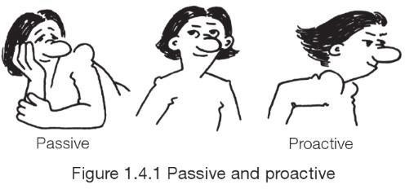
Success starts here
Failure starts here too
What you choose to do now will impact on your destiny

Slide 22


Organizing Your Team

Slide 23
How’s the BCIS Project different?
You won’t be given the answers, but maybe you’ll get help with some of the
questions to ask. You will transition into the unknown.
Need to become a self-organising & self-managing team. A supervisor will not micro-manage your team
The team will need to learn new things that are needed for your project
There will even be gaps to fill that you aren’t even aware of yet!

Slide 24
Required for R & D teamwork
Works well in a team environment
“plays nicely with others”
Shows Initiative
“Sees what needs doing and
does it”
“Wants to learn and isn’t
scared of teamwork”
Highly Motivated
Respectful
“to others”
Technical skills are evaluated but secondary to
above attributes
Evidence the above in your worklog book for reflective report and job interviews

Slide 25
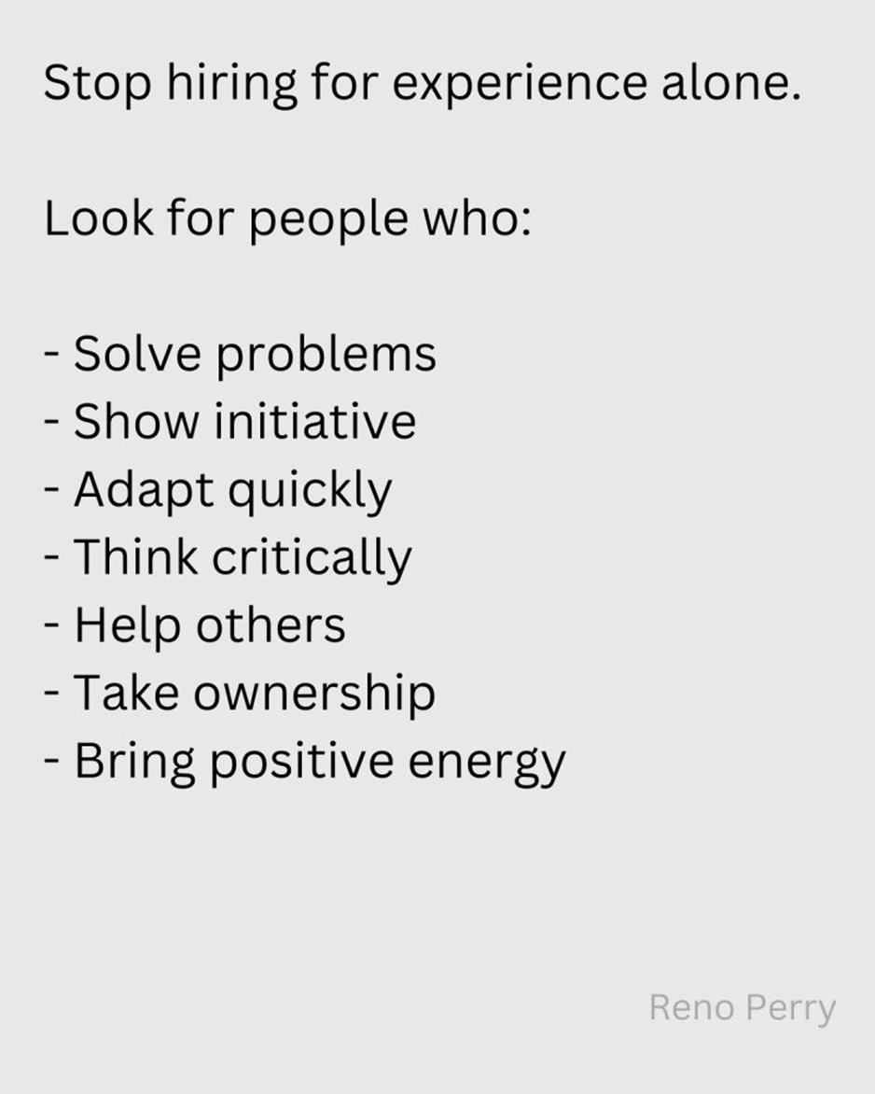
Source: Linkedin

Slide 26
Build a team culture
Collective team effort
Task sharing
Leadership in tasks
Coaching and mentoring
Quality driven

Slide 27
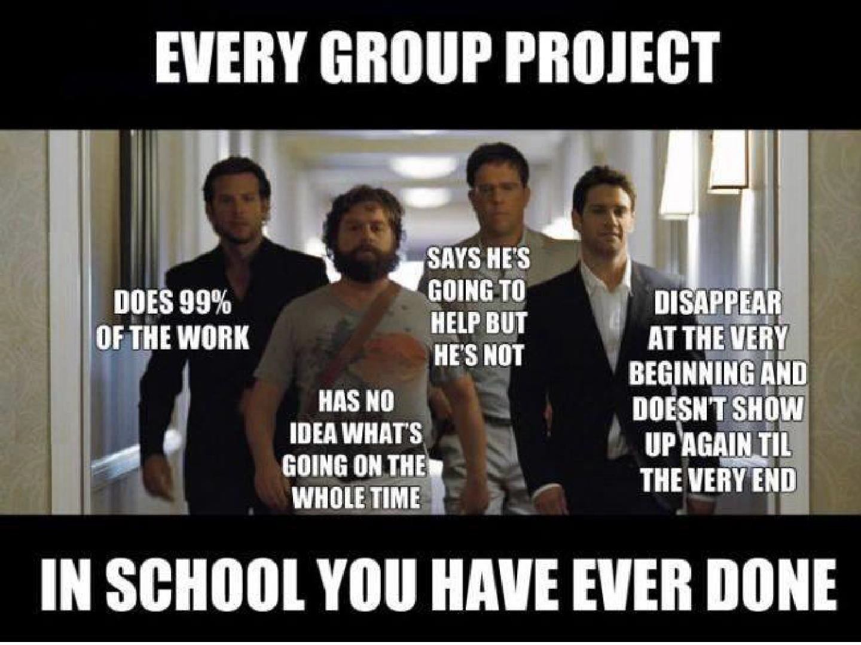

Slide 28
First R & D assessment- Prepare and present a R & D proposal- 10%
What is a R & D proposal? (cover more on this next week)
Due Week 6, panel presentation- team, supervisor, moderator (plus R & D teaching team) and duration 45 minutes.
Get started asp so that your team can come up with a reliable proposal
Templates for plans- use PMI templates (provided on Canvas) or client
templates

Slide 29
Project proposal- the following plans and documents may be useful for your project.
Team contract (download PMI code of conduct)
Project charter
Conflict resolution process
Stakeholder register
Stakeholder management strategy
Communication plan-
template (agenda and minutes) for team, mentor, client meetings),
Off-site (R & D lab) schedule for the semester (12-15 hours per week)
Mentor meeting schedule for the semester
Client meeting schedule & project updates (status) for the semester
Feasibility study document (technical, operational, economic, & schedule feasibility- fact-finding)
Will help to identify and justify the issue/opportunity-(rationale for project) , identify project scope, long and short-term benefits of the proposed solution, identify all stakeholders (client side) impacted by the project, infrastructure & skills needed to deliver the project, risks etc.
Requirements document (capture all possible high-level requirements)
Scope statement document- functional/non-functional/regulatory requirements;
project/product deliverables; project success criteria)
WBS- Approach/Method including individual practices
Project schedule
Milestone Report
Document that identifies required technical infrastructure, roles and skills to deliver the project
Adopted team roles & tasks
Team skills register, including missing skills
Training plan
Change management plan
Quality assurance plan
Risk register
Issue log register
Project review plan

Slide 30
Focus for the week once you know your project team

Slide 31
1. Team meeting
Have a kick-off team meeting to get to know each other, discuss the project scope, client, mentor & offsite schedule, etc.
Select a project manager. Your team will need a project manager (team leader)- for coordination and communication. However, all decision-making must be a collective team responsibility.
Write up your team contract
Think about the team structure- an appropriate structure must be adopted once a good understanding is gained of the project scope, stakeholders, method, and practices [WBS]). This may take a few weeks to sort out.
Any role (job expectations and tasks) would be based on 12 to 15 hours of work per week

Slide 32
Look into industry roles for your R & D project
Based on your Major, what industry role are you targeting when you
graduate?
Identify knowledge, skills requirements & tasks associated with the role
Adopt and practice the role as much as possible in your R & D project
What skills do you have now for the role? What skills are missing for the project? Hence,
identify the skills you would want to achieve.
M/C and document over the project timeline (two semesters) to identify what you have achieved or did not achieve.
you will understand reality and have facts for writing the reflective report and information for
job interviews

Slide 33
2. Supervisor meeting
Contact your academic supervisor as soon as possible. Provide your team’s contact details and schedule. Identify a schedule of the team’s times when all members of the team are free to meet.
Arrange for a mentor kick-off meeting (short one, 15-20 minutes)
Agenda- project and team intro, identify weekly meeting (day/time) & agenda items for weekly mentor meetings, including when and how to approach the client for the first meeting (target to meet the client by the end of next week).
Galaxy Team
Members: | Email addresses
Ford Prefect | fp@betelgeuse.gal
Trillian | tr@betelgeuse.gal
Marvin | marvin@betelgeuse.gal
Zaphod Beeblebrox | zaphod@betelgeuse.gal
Table below indicates days and times when all team members are free to meet
 | Monday | Tuesday | Wednesday | Thursday | Friday
9am
10am
11am
noon
1pm
2pm
3pm
4pm
5pm
 |  | = available

Slide 34
3. Understanding the scope
Research work & fact finding (most important thing in any project)
Heaps of similar types of products on the web for product ideas
Client meetings- extract information on the product ideas that they have including gathering information on their current IT infrastructure
Identify and capture all the possibilities for product ideas
Features, epics, or high-level requirements for the product, captured in the requirements document- keep updating this throughout the project as new ideas emerge.
Have client agreement on the ones which your team will deliver- Scope
Statement document.
Note- for the proposal, you don’t need to create analysis and design models or a product backlog. These will be done when the plans in your proposal are executed and will be part of your mid-term project review.

Slide 35
Next week
Focus on Project proposal

Slide 36
Referencing- use APA 7th Edition
https://aut.ac.nz.libguides.com/APA7th

